Slide 1
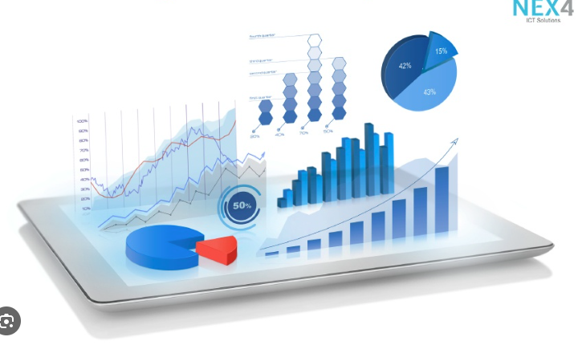




Data Visualization
in Power BI
04 Interactive Report
Prepared By :
Said Fawzy
Manager of Information Center
Tendering Department
Arab Contractors

Slide 2

1
Custom Tooltip
2
Drill Through
3
Bookmarks
4
Navigation

Slide 3
5
Filtering
6
Slicers
7
Cross-Filter and Cross-Highlight
8
Buttons

Slide 4
1
Custom Tooltip

Slide 5
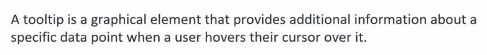
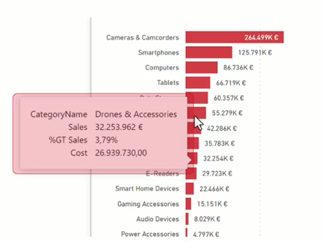
Tooltips

Slide 6
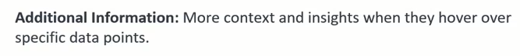
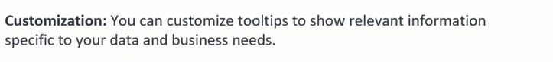
Tooltips

Slide 7
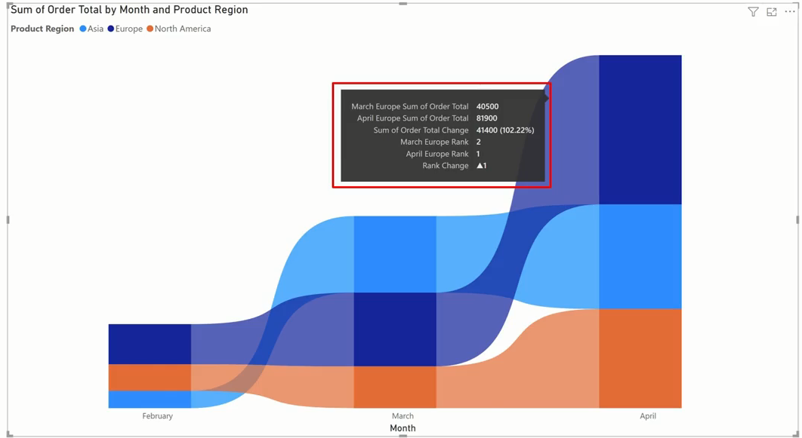
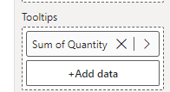
Default Tooltips

Slide 8
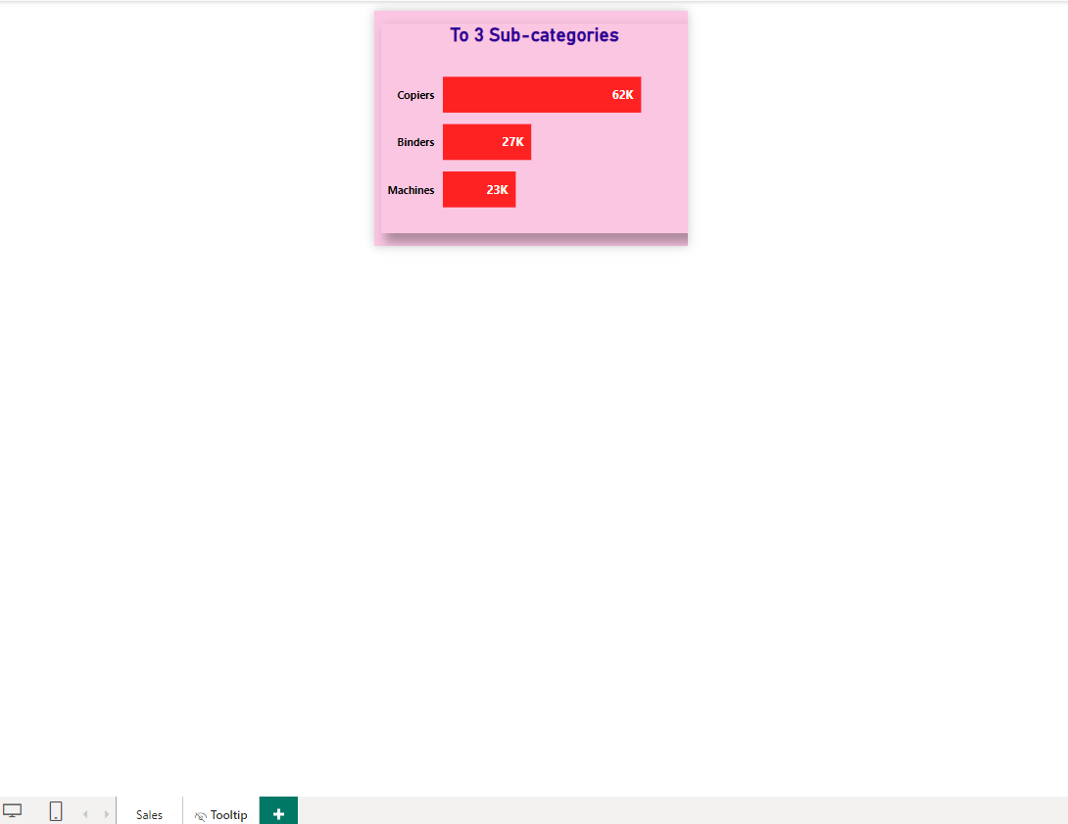
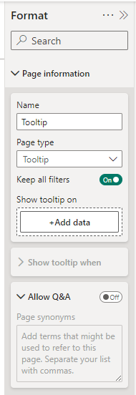
Custom Tooltips

Slide 9
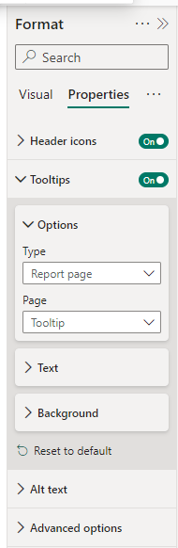
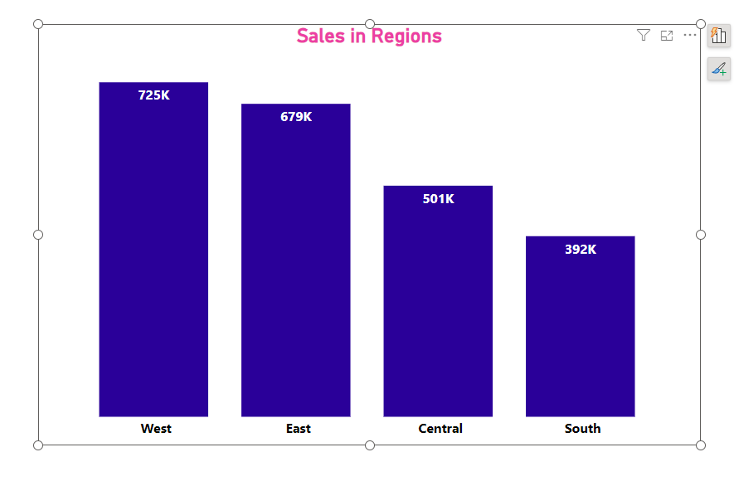
Custom Tooltips

Slide 10

Exercise 20 :
Create Custom tooltip

Slide 11
Question
What is the purpose of custom tooltips in Microsoft Power BI?
A. Custom tooltips enhance user engagement by providing interactive insights.
B. Custom tooltips enhance the aesthetic appeal of visuals.
C. Custom tooltips automatically update report data.
D. Custom tooltips enable connection to multiple data sources at once.

Slide 12
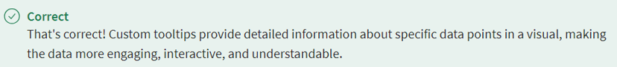
ANSWER
What is the purpose of custom tooltips in Microsoft Power BI?
A. Custom tooltips enhance user engagement by providing interactive insights.
B. Custom tooltips enhance the aesthetic appeal of visuals.
C. Custom tooltips automatically update report data.
D. Custom tooltips enable connection to multiple data sources at once.

Slide 13
2
Drill Through

Slide 14
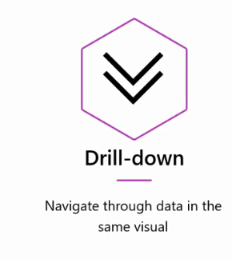
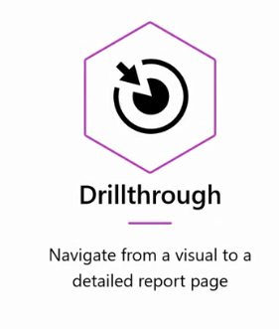
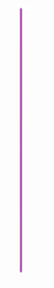
Drill Through

Slide 15
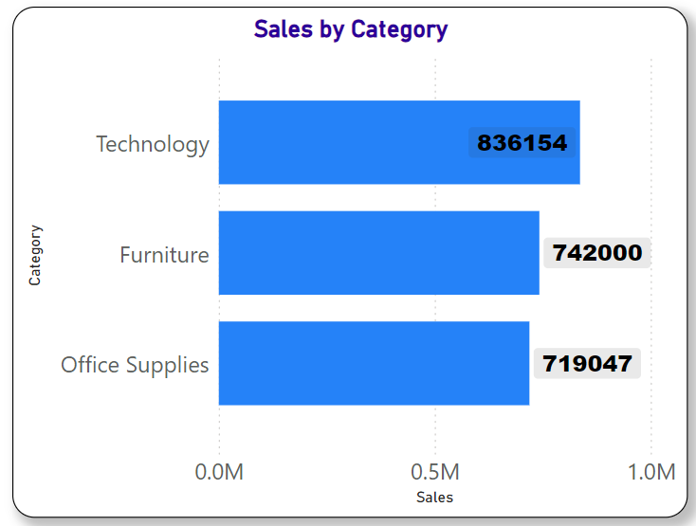
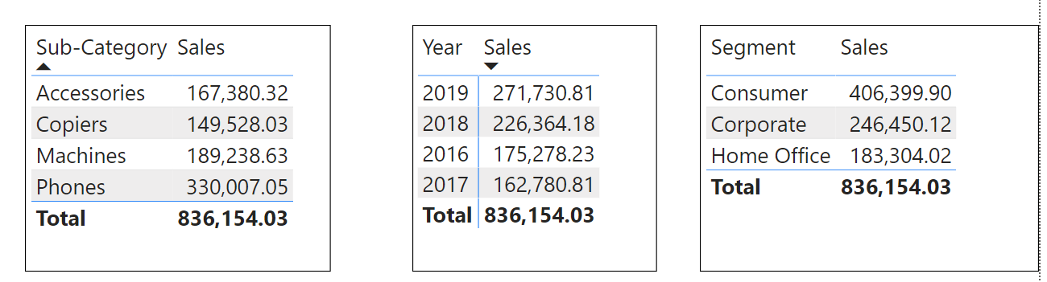
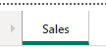
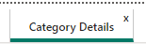
Drill Through

Slide 16
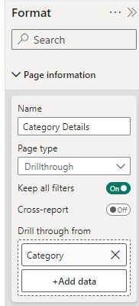
Drill Through

Slide 17
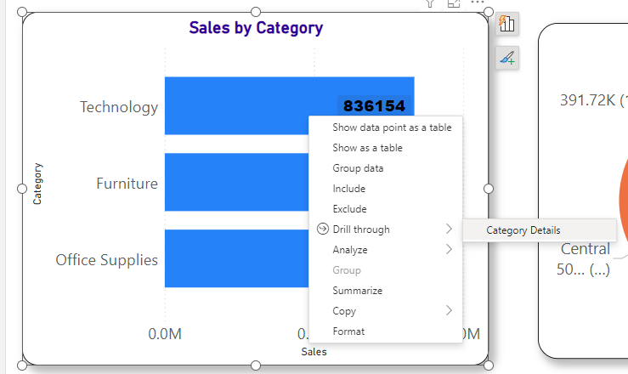
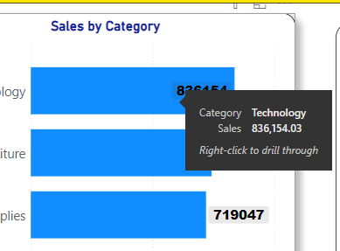
Drill Through

Slide 18
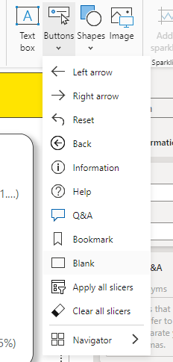
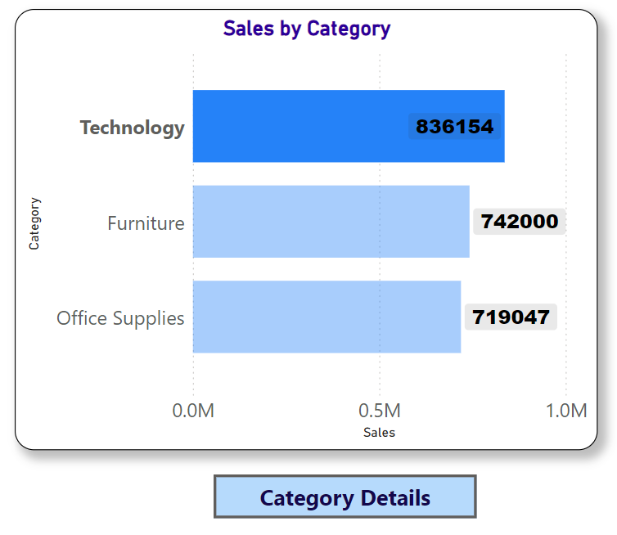
Drill Through

Slide 19
Exercise 21 :
Drill Through

Slide 20
Question
What is the primary purpose of using drillthrough in Microsoft Power BI?
A. To navigate from a data point or visual in a main report to a detailed report page
B. To create hierarchies for data fields in the same visualization
C. To pivot data and change its orientation in a table
D. To drill down into data in the same visualization

Slide 21
ANSWER
What is the primary purpose of using drillthrough in Microsoft Power BI?
A. To navigate from a data point or visual in a main report to a detailed report page
B. To create hierarchies for data fields in the same visualization
C. To pivot data and change its orientation in a table
D. To drill down into data in the same visualization

Slide 22
3
Bookmarks

Slide 23

Bookmarks

Slide 24

Bookmarks
Every Department needs a filter to your report
to align with their responsibilities

Slide 25
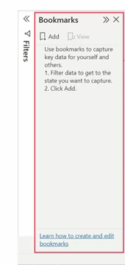

Bookmarks

Slide 26
Bookmarks
Apply Flites
Save State as a Bookmark
Select Bookmark
View Bookmarked State

Slide 27



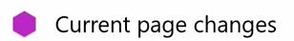

Bookmarks
4 State options you can save:

Slide 28

Bookmarks

Slide 29
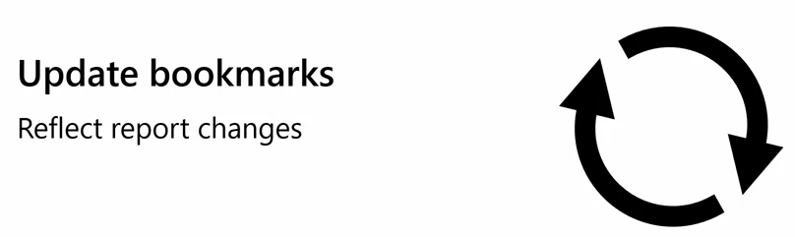
Bookmarks
By default, all states are saved for all visuals.
If you modify a report after you create a bookmark, any visualizations not present when you created the bookmark will appear in a default state. So, remember, if you change a report, you should make sure to update your bookmarks to reflect the changes.

Slide 30
Exercise 22 :
Bookmarks Basics

Slide 31

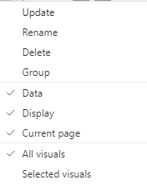
Bookmarks Options

Slide 32

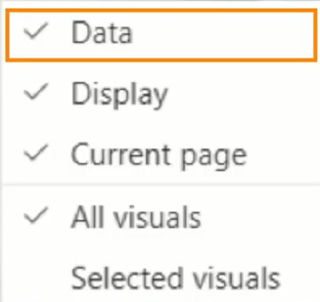
Bookmarks Options
When this option is ticked that is mean that all:
Filtering,
Drill through,
Sort Settings.
Are memorized by this bookmark.

Slide 33

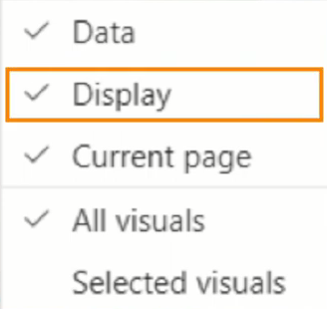
Bookmarks Options
When this option is ticked, Display states are memorized.
That means both:
Spotlight and
Visibility (shown or hidden).

Slide 34
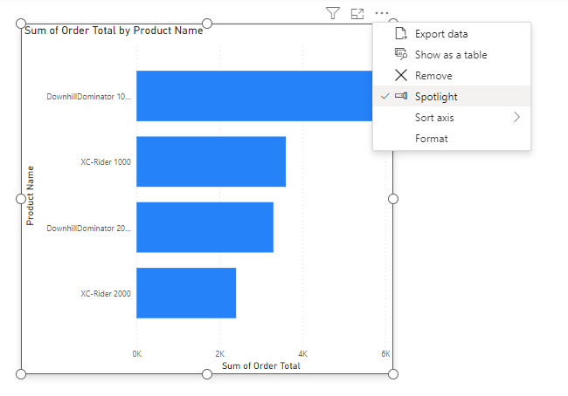
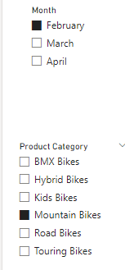
Bookmarks Options

Slide 35
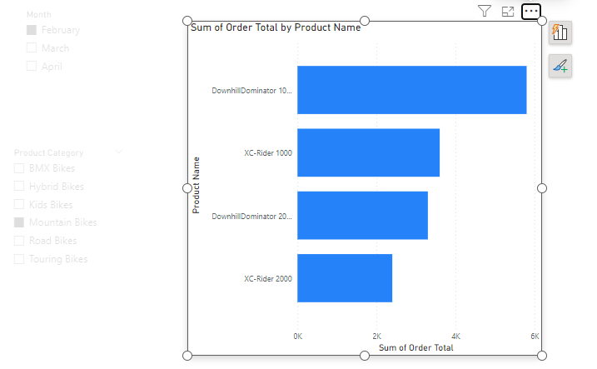

Bookmarks Options

Slide 36
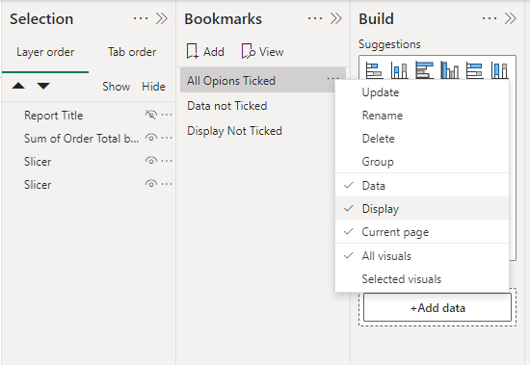
Bookmarks Options

Slide 37

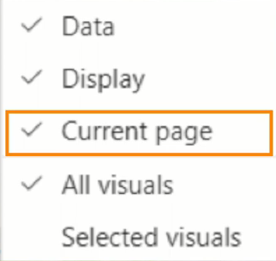
Bookmarks Options
•It means that if you click the bookmark it will take you to the page that was current when you created the bookmark.

Slide 38

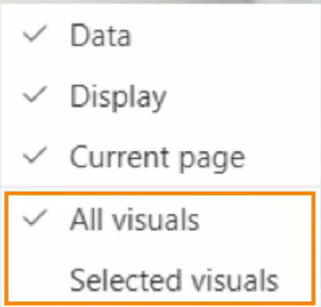
Bookmarks Options
Do you want the bookmark to remember settings and data for all visuals on the page or only the Selected Visuals from the Selection pane when you created the bookmark.

Slide 39
Exercise 23 :
Bookmarks Options

Slide 40
Question
You added new visualizations to a report after previously creating a bookmark with the default options. When you select the bookmark, which of the following statements are true? Select all that apply.
A. The new visualizations will appear in a default state.
B. The new visualizations will have the bookmarked filters applied to it.
C. The previous visualizations will have the bookmarked filters applied to it.
D. The current page of the report will change to the bookmarked page.

Slide 41
ANSWER
You added new visualizations to a report after previously creating a bookmark with the default options. When you select the bookmark, which of the following statements are true? Select all that apply.
A. The new visualizations will appear in a default state.
B. The new visualizations will have the bookmarked filters applied to it.
C. The previous visualizations will have the bookmarked filters applied to it.
D. The current page of the report will change to the bookmarked page.

Slide 42
4
Navigation

Slide 43
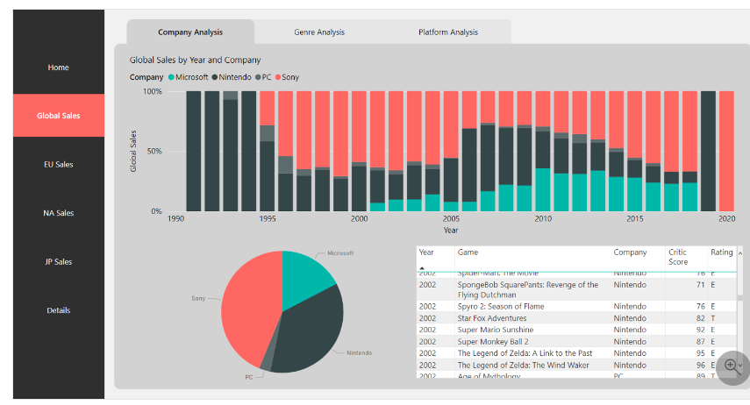
Navigation

Slide 44

Navigation
Add Buttons Manually.
Page Navigator.
Bookmark Navigator.

Slide 45
Exercise 24 :
Page Navigator and
Bookmark Navigator

Slide 46
5
Filtering

Slide 47
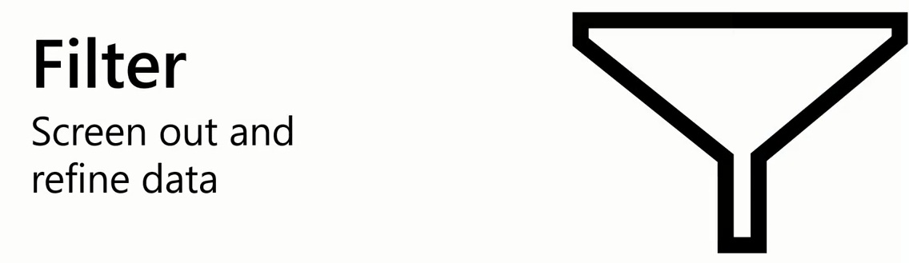
Filter

Slide 48
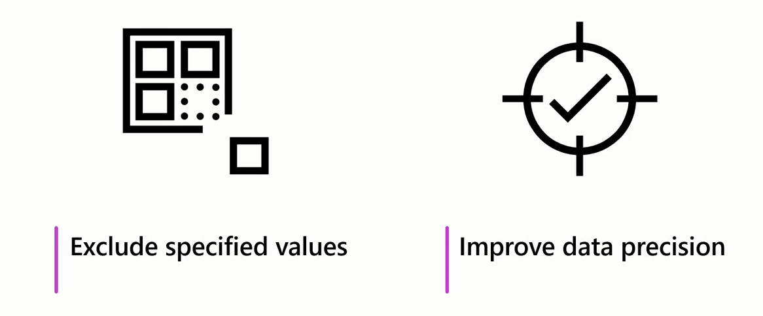
Filter

Slide 49
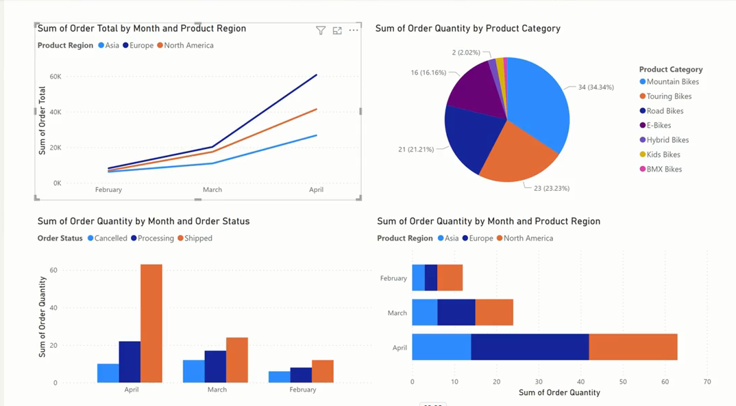
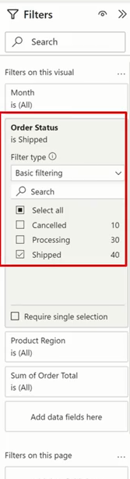
Filter
Example: we do not want canceled orders or in processing ones

Slide 50

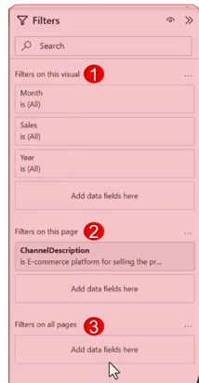
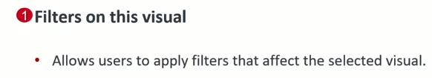
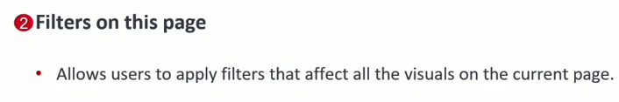
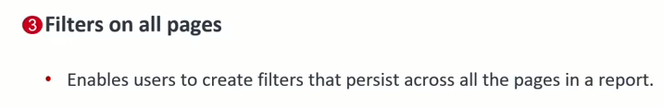
Filter

Slide 51
Exercise 25:
Filtering Context

Slide 52
Question
Which of the following statements best describes the purpose of filtering in data analysis?
A. To change the graphical representation of the data
B. To screen out or focus on parts of the data based on specific conditions
C. To arrange data in a sequential manner
D. To highlight specific cells or rows in a dataset based on certain criteria or rules

Slide 53
ANSWER
Which of the following statements best describes the purpose of filtering in data analysis?
A. To change the graphical representation of the data
B. To screen out or focus on parts of the data based on specific conditions
C. To arrange data in a sequential manner
D. To highlight specific cells or rows in a dataset based on certain criteria or rules

Slide 54
6
Slicers

Slide 55

Slicers
A slicer is a great way to apply common filters to a report page quickly

Slide 56
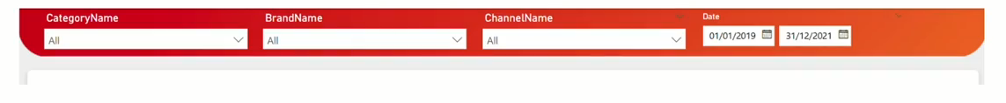
Slicers

Slide 57

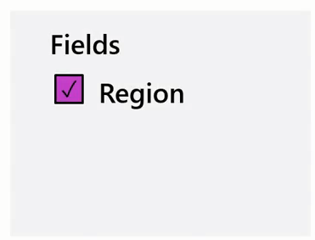
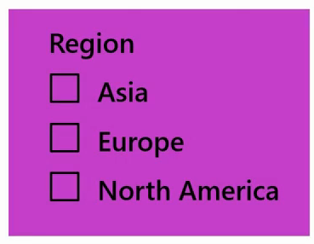
Slicers
The slicer can be displayed in multiple formats depending on the field on which the slicer is filtering.

Slide 58

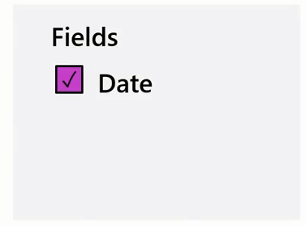
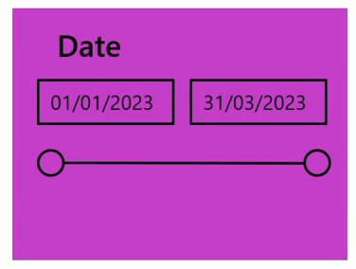
Slicers
The slicer can be displayed in multiple formats depending on the field on which the slicer is filtering.

Slide 59

Slicers

Slide 60
Exercise 26:
Creating Slicers

Slide 61

Slicers

Slide 62

Slicers

Slide 63


Slicers

Slide 64
Exercise 27:
Synchronize Slicers

Slide 65
Question
When synchronizing slicers, which of the following ensures that a slicer synchronizes when other slicers or visualizations are interacted with? Select all that apply.
A. Navigate to the View menu and select Sync Slicers
B. Ensure that the group name is consistent
C. Enable Sync filter changes to other slicers
D. Enable Sync field changes to other slicers

Slide 66
ANSWER
When synchronizing slicers, which of the following ensures that a slicer synchronizes when other slicers or visualizations are interacted with? Select all that apply.
A. Navigate to the View menu and select Sync Slicers
B. Ensure that the group name is consistent
C. Enable Sync filter changes to other slicers
D. Enable Sync field changes to other slicers

Slide 67
7
Cross-Filter and Cross-Highlight

Slide 68

Cross-Filter and Cross-Highlight

Slide 69

Cross-Filter and Cross-Highlight

Slide 70

Cross-Filter and Cross-Highlight

Slide 71
Cross-Filter and Cross-Highlight
Default behavior in Power BI

Slide 72

Cross-Filter and Cross-Highlight

Slide 73

Cross-Filter and Cross-Highlight
Change Default behavior

Slide 74



Cross-Filter and Cross-Highlight
Filter Highlight Non
Change Behavior Individually

Slide 75
Exercise 28:
Cross-Filter and
Cross-Highlight

Slide 76
Question
What best describes the function of cross-filtering in visual reports?
A. It displays the raw data of the selected visual.
B. It highlights the selected data across multiple visuals without changing the displayed data.
C. It highlights specific cells or rows in a dataset based on certain criteria or rules.
D. It allows a selection in one visual to filter out unrelated data in another visual.

Slide 77
ANSWER
What best describes the function of cross-filtering in visual reports?
A. It displays the raw data of the selected visual.
B. It highlights the selected data across multiple visuals without changing the displayed data.
C. It highlights specific cells or rows in a dataset based on certain criteria or rules.
D. It allows a selection in one visual to filter out unrelated data in another visual.

Slide 78
8
Buttons

Slide 79

Buttons

Slide 80

Buttons

Slide 81

Buttons

Slide 82


Buttons

Slide 83

Create Buttons

Slide 84

Customize Buttons

Slide 85



Add a custom image or icon to Button

Slide 86

Add effects to Button

Slide 87

Buttons

Slide 88

Buttons

Slide 89

Buttons

Slide 90

Buttons
Drill Through

Slide 91

Buttons

Slide 92


Buttons

Slide 93

Buttons
Web URL

Slide 94

Buttons

Slide 95
Button states
Button states
Buttons in Power BI have four possible states:
Default: How buttons appear when not hovered over or selected.
On hover: How buttons appear when hovered over.
On press: How buttons appear when selected.
Disabled: How buttons appear when they can't be selected.

Slide 96
Exercise 29:
Create Buttons

Slide 97


Slide 98
Question 1
You're creating a Microsoft Power BI report for a supply chain management team. They need the ability to drill through to detailed information about specific products when clicking on a product category in a visual. Which actions are necessary to set up drillthrough capabilities for this scenario? Select all that apply.
A. Create a drillthrough page with relevant visuals and filters.
B. Add conditional formatting to the product category field.
C. Change the theme of the report to match the supply chain branding.
D. Define drillthrough filters on the product category field.

Slide 99


ANSWER 1
You're creating a Microsoft Power BI report for a supply chain management team. They need the ability to drill through to detailed information about specific products when clicking on a product category in a visual. Which actions are necessary to set up drillthrough capabilities for this scenario? Select all that apply.
A. Create a drillthrough page with relevant visuals and filters.
B. Add conditional formatting to the product category field.
C. Change the theme of the report to match the supply chain branding.
D. Define drillthrough filters on the product category field.

Slide 100
Question 2
You have created a Microsoft Power BI report with several pages. You have added a bookmark to easily navigate to a specific filtered state. A viewer has requested that the report page shouldn’t change when the bookmark is clicked. Which action should you take?
A. Replace the bookmark with a button
B. Disable the current page option for the bookmark
C. Replace the bookmark with a slicer

Slide 101
ANSWER 2
You have created a Microsoft Power BI report with several pages. You have added a bookmark to easily navigate to a specific filtered state. A viewer has requested that the report page shouldn’t change when the bookmark is clicked. Which action should you take?
A. Replace the bookmark with a button
B. Disable the current page option for the bookmark
C. Replace the bookmark with a slicer

Slide 102
Question 3
In Microsoft Power BI, when you interactively select a data point in one visual, and other visuals on the same page are filtered to show related data points, which feature is being used?
A. Drillthrough
B. Slicer filtering
C. Cross-highlighting
D. Cross-filtering

Slide 103

ANSWER 3
In Microsoft Power BI, when you interactively select a data point in one visual, and other visuals on the same page are filtered to show related data points, which feature is being used?
A. Drillthrough
B. Slicer filtering
C. Cross-highlighting
D. Cross-filtering

Slide 104
Question 4
What are the benefits of adding slicers to a report? Select all that apply.
A. Faster loading of visualizations
B. Improved interactivity
C. Improved user experience

Slide 105


ANSWER 4
What are the benefits of adding slicers to a report? Select all that apply.
A. Faster loading of visualizations
B. Improved interactivity
C. Improved user experience

Slide 106


